Slide 1
All
About…
Ms. Caballero
An autobiography featuring your
teacher!
Brooke Hilderbrand © 2012

Slide 2
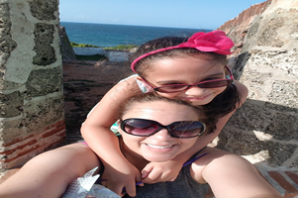
My Family:
I have an 8 year old daughter named Sofia. We live in Pingree Grove, IL.
#
Brooke Hilderbrand © 2012

Slide 3
My Favorite
Things:
Food:
Color: Blue
Animal:
Holiday:
Sport:
Movie:
Subject:
Mofongo al ajillo
Teacup Pomeranian
Christmas
Sailing
Moana
Reading
#
Brooke Hilderbrand © 2012

Slide 4
My Favorite
Books:
Genre:
Author:
Illustrator:
Children’s Book:
Fairy Tales
Robert Munsch
Eric Carle
The Paper Bag Princess
#
Brooke Hilderbrand © 2012

Slide 5
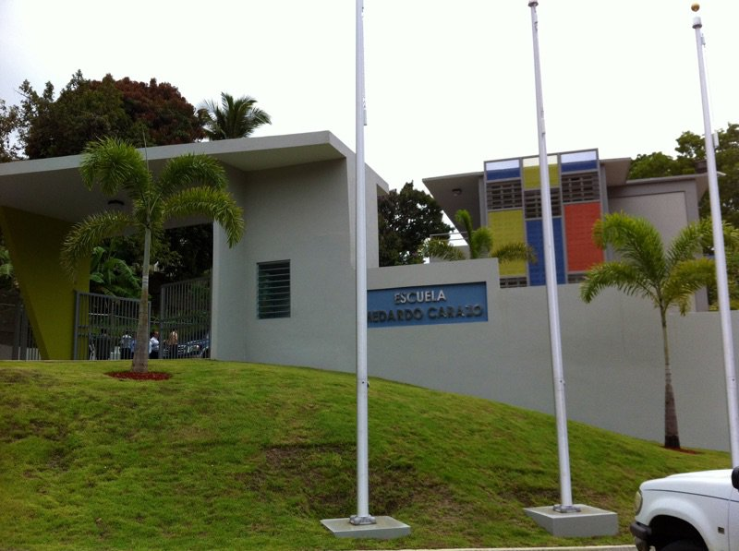
When I was in
school:
I loved growing up and going to school in
Puerto Rico!
Favorite Subject:
Favorite Lunch:
Favorite Game:
Math
Chicken
Hide and Seek
#
Brooke Hilderbrand © 2012

